Slide 1
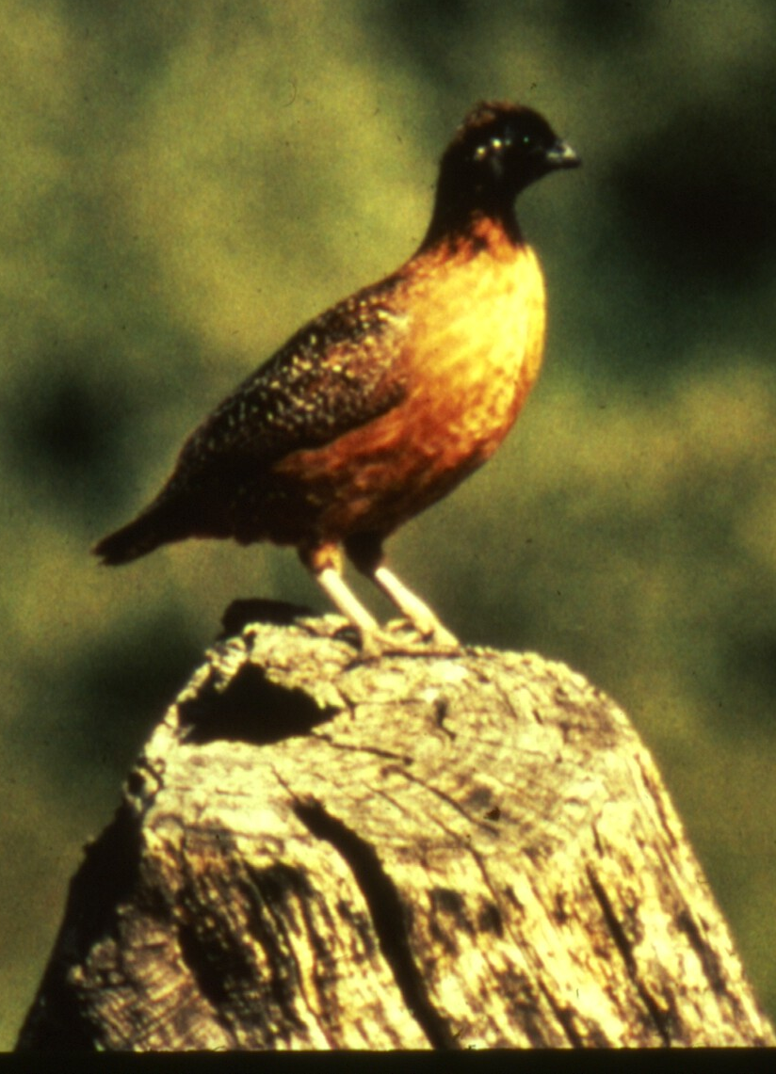
Developing a habitat suitability model for masked bobwhite quail from expert opinion
Dominic LaRoche¹ and Courtney Conway²
¹ University of Arizona School of Natural Resources
² USGS University of Idaho Cooperative Fish and Wildlife Research Unit

Slide 2
Project Goals
Interview species experts to determine important habitat features
Notes:
Due to a lack of published literature on the masked bobwhite quail and the difficulty in conducting research on wild quail we attempted to conduct research through interviews with experts who have worked with masked bobwhite quail in the field. We first contacted experts and set up in-person interviews to determine what the important habitat factors were and what their relationship to masked bobwhite quail was.

Slide 3
Project Goals
Interview species experts to determine important habitat features
Use both established literature and results from interviews to determine the relationship between important habitat features and masked bobwhite quail
Notes:
We are currently working on the 2nd project goal of combining results from expert interviews with that of the published literature to define the relationship between important habitat variables and masked bobwhite quail.

Slide 4
Project Goals
Interview species experts to determine important habitat features
Use both established literature and results from interviews to determine the relationship between important habitat features and masked bobwhite quail
Translate theoretical and qualitative relationships between habitat features and masked bobwhite quail into a suite of mathematical habitat suitability index models
Notes:
Once we have collected all of the information on these habitat variables from experts we will then create a series of habitat suitability models. 1 for each expert and paper and synthesis model which attempts to incorporate each individual model through a weighting system.

Slide 5
Project Goals
Interview species experts to determine important habitat features
Use both established literature and results from interviews to determine the relationship between important habitat features and masked bobwhite quail
Translate theoretical and qualitative relationships between habitat features and masked bobwhite quail into a suite of mathematical habitat suitability index models
Use models in conjunction with remote sensing to find existing suitable habitat for masked bobwhite quail
Notes:
We will then use these models, in conjuction with remote sensing to identify existing masked bobwhite habitat.

Slide 6
Project Goal #1: Expert Interviews
Identified 12 masked bobwhite experts to interview

Slide 7
Project Goal #1: Expert Interviews
Identified 12 masked bobwhite experts to interview
Conducted 9 interviews

Slide 8
Project Goal #1: Expert Interviews
Identified 12 masked bobwhite experts to interview
Conducted 9 interviews
What has prevented masked bobwhite from establishing or recovering?
What are the most important habitat variables for masked bobwhite?
How does season affect these variables and their importance?

Slide 9
Project Goal #1: Expert Interviews
Identified 19 different “issues” with the recovery of masked bobwhite quail
Mamalian Predators
Winter Food
Invasive Species
Climate/ Edge of Range
Summer Forb diversity
Shrub and Brush Cover
Grass Cover
Tree Cover
Woodland/ Grassland Edges
Breeding Problems
Leguminous Shrubs
Avian Predators
Thermal Refugia
Bare ground
Vegetation Height (herbaceous)
Water
Summer Food
Herbaceous Species Diversity
Structural Diversity
Arthropod Diversity
Released Birds Unfit for the Wild
Notes:
Not all of the important variables experts brought up were related to habitat.

Slide 10
“Issues” with Quail Recovery
Mamalian Predators
Winter Food
Invasive Species
Climate/ Edge of Range
Summer Forb diversity
Shrub and Brush Cover
Grass Cover
Tree Cover
Woodland/ Grassland Edges
Breeding Problems
Leguminous Shrubs
Avian Predators
Thermal Refugia
Bare ground
Vegetation Height (herbaceous)
Water
Summer Food
Herbaceous Species Diversity
Structural Diversity
Arthropod Diversity
Released Birds Unfit for the Wild
List includes:
Issues unrelated to habitat
Notes:
Things such as breeding problems or the suitability of released birds are beyond the scope of this project and so will not be considered further in this study.

Slide 11
“Issues” with Quail Recovery
Mamalian Predators
Winter Food
Invasive Species
Climate/ Edge of Range
Summer Forb diversity
Shrub and Brush Cover
Grass Cover
Tree Cover
Woodland/ Grassland Edges
Breeding Problems
Leguminous Shrubs
Avian Predators
Thermal Refugia
Bare ground
Vegetation Height (herbaceous)
Water
Summer Food
Herbaceous Species Diversity
Structural Diversity
Arthropod Diversity
Released Birds Unfit for the Wild
List includes:
Issues unrelated to habitat
Ultimate Habitat Factors
Notes:
Moreover, we identified variables which could be considered ultimate factors. Factors that describe the ecological conditions to which the birds are either indirectly or directly responding but which are not directly measureable.

Slide 12
“Issues” with Quail Recovery
Mamalian Predators
Winter Food
Invasive Species
Climate/ Edge of Range
Summer Forb diversity
Shrub and Brush Cover
Grass Cover
Tree Cover
Woodland/ Grassland Edges
Breeding Problems
Leguminous Shrubs
Avian Predators
Thermal Refugia
Bare ground
Vegetation Height (herbaceous)
Water
Summer Food
Herbaceous Species Diversity
Structural Diversity
Arthropod Diversity
Released Birds Unfit for the Wild
List includes:
Issues unrelated to habitat
Ultimate Habitat Factors
Proximate Habitat Factors
Notes:
Along with the ultimate factors, the list includes proximate factors. These are directly measureable habitat features.

Slide 13
Ultimate vs Proximate Factors
Ultimate Factors
Proximate Factors
Shrub and Brush Cover
Thermal Refugia
Leguminous Shrubs
Winter Food
Vegetation Height
Avian and Mammalian Predators
Structural Diversity of Vegetation
Notes:
Of course, ultimate and proximate factors are related and the relationship is not always clear so for now we will keep both types of factors in our list and we will attempt to consolidate for the 4th and 5th project objectives.

Slide 14
Importance of Variables (From Interviews)
 | Avian Predators | Winter Food | Invasive Plant spp | Climate | Woodland /Grassland Edges | Thermal Refugia | Brush and Shrub Cover | Vegetation Height (herbaceous) | Leguminous Shrubs | Vegetation Structural Diversity | Arthropod Diversity and Abundance | Bare Ground | Grass Cover | Tree Cover | Mammalian Predators | Herbaceous Species Diversity | Forb Cover
Expert 1 | 1 |  |  |  |  |  |  |  |  |  |  |  |  | 1 | 2
Expert 2 |  | 1 | 2 | 3 |  |  |  |  | 1 |  | 4 |  |  |  |  | 4
Expert 3 |  |  |  | 1 |  | 2 | 3 |  |  | 5 |  | 4 | 5 | 2 |  | 6 | 3
Expert 4 | 8 | 3 | 7 | 6 | 2 |  | 3 | 9 | 3 |  |  | 4 | 1 |  | 8 |  | 5
Expert 5 | 4 | 1 |  |  | 5 | 3 | 2 |  |  | 5 |  |  | 6 | 6 | 4 |  | 6
Expert 6 |  | 6 |  |  | 4 |  | 3 |  |  | 1 | 6 |  | 4 | 5 |  | 2 | 6
Expert 7 |  |  | 1 | 1 | 3 |  | 5 |  | 2 | 3 |  | 4 | 3 | 6 |  | 1 | 2
Expert 8 |  |  | 16 | 1 |  |  | 6 |  | 3 |  |  |  | 5 |  |  | 2 | 4
Expert 9 |  |  |  | 1
 | Very Important and Good |  |  |  |  |  |  |  | Very Important and Bad
Notes:
Here is a heat map of the 16 variables (after removing non-habitat variables) experts mentioned in our interviews.

Slide 15
Importance of Variables (From Interviews)
Some strong agreement on variables
 | Avian Predators | Winter Food | Invasive Plant spp | Climate | Woodland /Grassland Edges | Thermal Refugia | Brush and Shrub Cover | Vegetation Height (herbaceous) | Leguminous Shrubs | Vegetation Structural Diversity | Arthropod Diversity and Abundance | Bare Ground | Grass Cover | Tree Cover | Mammalian Predators | Herbaceous Species Diversity | Forb Cover
Expert 1 | 1 |  |  |  |  |  |  |  |  |  |  |  |  | 1 | 2
Expert 2 |  | 1 | 2 | 3 |  |  |  |  | 1 |  | 4 |  |  |  |  | 4
Expert 3 |  |  |  | 1 |  | 2 | 3 |  |  | 5 |  | 4 | 5 | 2 |  | 6 | 3
Expert 4 | 8 | 3 | 7 | 6 | 2 |  | 3 | 9 | 3 |  |  | 4 | 1 |  | 8 |  | 5
Expert 5 | 4 | 1 |  |  | 5 | 3 | 2 |  |  | 5 |  |  | 6 | 6 | 4 |  | 6
Expert 6 |  | 6 |  |  | 4 |  | 3 |  |  | 1 | 6 |  | 4 | 5 |  | 2 | 6
Expert 7 |  |  | 1 | 1 | 3 |  | 5 |  | 2 | 3 |  | 4 | 3 | 6 |  | 1 | 2
Expert 8 |  |  | 16 | 1 |  |  | 6 |  | 3 |  |  |  | 5 |  |  | 2 | 4
Expert 9 |  |  |  | 1
 | Very Important and Good |  |  |  |  |  |  |  | Very Important and Bad
Notes:
As you can see, some variables had strong agreement between experts.

Slide 16
Importance of Variables (From Interviews)
Some modest agreement on variables
 | Avian Predators | Winter Food | Invasive Plant spp | Climate | Woodland /Grassland Edges | Thermal Refugia | Brush and Shrub Cover | Vegetation Height (herbaceous) | Leguminous Shrubs | Vegetation Structural Diversity | Arthropod Diversity and Abundance | Bare Ground | Grass Cover | Tree Cover | Mammalian Predators | Herbaceous Species Diversity | Forb Cover
Expert 1 | 1 |  |  |  |  |  |  |  |  |  |  |  |  | 1 | 2
Expert 2 |  | 1 | 2 | 3 |  |  |  |  | 1 |  | 4 |  |  |  |  | 4
Expert 3 |  |  |  | 1 |  | 2 | 3 |  |  | 5 |  | 4 | 5 | 2 |  | 6 | 3
Expert 4 | 8 | 3 | 7 | 6 | 2 |  | 3 | 9 | 3 |  |  | 4 | 1 |  | 8 |  | 5
Expert 5 | 4 | 1 |  |  | 5 | 3 | 2 |  |  | 5 |  |  | 6 | 6 | 4 |  | 6
Expert 6 |  | 6 |  |  | 4 |  | 3 |  |  | 1 | 6 |  | 4 | 5 |  | 2 | 6
Expert 7 |  |  | 1 | 1 | 3 |  | 5 |  | 2 | 3 |  | 4 | 3 | 6 |  | 1 | 2
Expert 8 |  |  | 16 | 1 |  |  | 6 |  | 3 |  |  |  | 5 |  |  | 2 | 4
Expert 9 |  |  |  | 1
 | Very Important and Good |  |  |  |  |  |  |  | Very Important and Bad
Notes:
Others had moderate agreement

Slide 17
Importance of Variables (From Interviews)
Some disagreement on variables
 | Avian Predators | Winter Food | Invasive Plant spp | Climate | Woodland /Grassland Edges | Thermal Refugia | Brush and Shrub Cover | Vegetation Height (herbaceous) | Leguminous Shrubs | Vegetation Structural Diversity | Arthropod Diversity and Abundance | Bare Ground | Grass Cover | Tree Cover | Mammalian Predators | Herbaceous Species Diversity | Forb Cover
Expert 1 | 1 |  |  |  |  |  |  |  |  |  |  |  |  | 1 | 2
Expert 2 |  | 1 | 2 | 3 |  |  |  |  | 1 |  | 4 |  |  |  |  | 4
Expert 3 |  |  |  | 1 |  | 2 | 3 |  |  | 5 |  | 4 | 5 | 2 |  | 6 | 3
Expert 4 | 8 | 3 | 7 | 6 | 2 |  | 3 | 9 | 3 |  |  | 4 | 1 |  | 8 |  | 5
Expert 5 | 4 | 1 |  |  | 5 | 3 | 2 |  |  | 5 |  |  | 6 | 6 | 4 |  | 6
Expert 6 |  | 6 |  |  | 4 |  | 3 |  |  | 1 | 6 |  | 4 | 5 |  | 2 | 6
Expert 7 |  |  | 1 | 1 | 3 |  | 5 |  | 2 | 3 |  | 4 | 3 | 6 |  | 1 | 2
Expert 8 |  |  | 16 | 1 |  |  | 6 |  | 3 |  |  |  | 5 |  |  | 2 | 4
Expert 9 |  |  |  | 1
 | Very Important and Good |  |  |  |  |  |  |  | Very Important and Bad
Notes:
And still others had disagreement. As a side note this information may be useful in directing future research to clarify these inconsistencies and settle some of these disputes.

Slide 18
Importance of Variables (From Interviews)
Habitat Variable | Rank | Weight⁻¹
Climate | 1 | -2.166667
Leguminous Shrubs | 2 | 2.25
Thermal Refugia | 3 | 2.5
Winter Food | 4 | 2.75
Herbaceous Species Diversity | 5 | 3
Woodland /Grassland Edges | 6 | 3.5
Vegetation Structural Diversity | 7 | 3.5
Brush and Shrub Cover | 8 | 3.666667
Bare Ground | 9 | 4
Grass Cover | 10 | 4
Tree Cover | 11 | 4
Avian Predators | 12 | -4.333333
Forb Cover | 13 | 4.333333
Mammalian Predators | 14 | -4.666667
Arthropod Diversity and Abundance | 15 | 5
Invasive Plant spp | 16 | 6.5
Vegetation Height (herbaceous) | 17 | 9

Slide 19
Importance of Variables (From Interviews)
Interview shortfalls:
Had to guess about the rank of some variables based on other comments
Did not get detail about the nature of the relationships between variables and quail
Secondary Surveys:
Confirm variable ranks
Investigate the relationship between proximate and ultimate factors
Gather detail about the relationships between variables and quail

Slide 20
Bivariate Relationships
Used existing literature and information from interviews to develop suites of bivariate relationships for each variable
Created theoretical probability density graphs associated with parameterized distributions
Beta (α, β) and restricted log-normal (μ, σ²) distributions for cover variables
Normal (μ, σ²) and log-normal (μ, σ²) distributions for other variables

Slide 21


Bivariate Relationships
Identified and approximated 9 different possible relationships between woody cover (brush and shrub) and masked bobwhite quail
$$\frac{1}{B\left(5,36.66\right)}x^{4}{(1−x)}^{35.66}$$
$$\frac{1}{B(2,5.27)}x{(1−x)}^{4.27}$$

Slide 22
Bivariate Relationships
We have currently developed a suite of possible relationships for 5 of the variables and sent them out for review by species experts
Woody Cover – 9 potential relationships
Bare Ground – 3 potential relationships
Nest Substrate Height – 3 potential relationships
Herbaceous Cover – 9 potential relationships
Visual Obstruction – 6 potential relationships
The number of relationships for each variable represents the diversity of opinion about that relationship from both expert interviews and published literature

Slide 23
Next Steps…
We will validate variable importance measures for each expert with information from our recent survey
We will create variable relationship graphs for the remaining variables identified from our expert interviews and solicit expert opinion for each
We will incorporate information from variable importance measures and relationship graphs to create individual habitat suitability index models for each expert

Slide 24
Next Steps…
We will validate variable importance measures for each expert with information from our recent survey
We will create variable relationship graphs for the remaining variables identified from our expert interviews and solicit expert opinion for each

Slide 25
Next Steps…
We will validate variable importance measures for each expert with information from our recent survey
We will create variable relationship graphs for the remaining variables identified from our expert interviews and solicit expert opinion for each
We will incorporate information from variable importance measures and relationship graphs to create individual habitat suitability index models for each expert

Slide 26
Next Steps…
We will validate variable importance measures for each expert with information from our recent survey
We will create variable relationship graphs for the remaining variables identified from our expert interviews and solicit expert opinion for each
We will incorporate information from variable importance measures and relationship graphs to create individual habitat suitability index models for each expert
We will create a consensus model by incorporating information from all experts into a single habitat suitability index model

Slide 27
Questions?

